Slide 1
Computer Basics
Chapter: 3

Slide 2
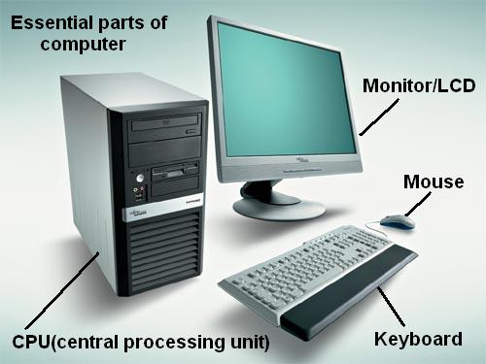
Introduction To Computer Basics
Initial computers did basic calculations.
Computers operate on binary numbers.
Foundation is based on three steps:
Input, signal fed to devices.
Process within the CPU (Central Processing Unit).
Output, result that comes after processing.

Slide 3
Parts Of A Computer
Input unit to feed data to computer through keyboard and mouse.
Output unit like visual units to provide information to user.
CU (Control Unit) for functioning of computer.
ALU (Arithmetic Logic Unit) to regulate arithmetic and logical operations.
Memory unit to store information.
Two memory types; primary memory is main memory and secondary memory for additional storage.
CPU (Central Processing Unit) is the main processor.
CPU contains ALU, CU and memory.

Slide 4
Types Of Devices: Input
MOUSE | The input device mouse is plugged into the CPU and functions as a direction indicator and operator that enables a user to select or deselect a file. It comes with two buttons (left and right) and a scroll wheel.
KEYBOARD | Designed in line with the olden typewriters, this input device comes with buttons (or keys) that contain all letters of the alphabet, numbers from 0 to 9, and an array of other special characters and operations.
MICROPHONE | The microphone is not an essential input device, but it can be used to capture audio signals by converting sound waves into electrical signals.
SCANNER | Scanners or image scanners are used to scan hard copies of documents or photographs and convert them to soft copies stored and viewed on a computer.
WEBCAM | Webcams came into the picture much later and can be used for clicking pictures, video conferencing, or recording.

Slide 5
Types Of Devices: Output
MONITOR | A computer system's main components and the best example of an output device. Although monitors these days come in LED or LCD variants, the first monitors were the boxed-shaped CRT ones.
PRINTER | Printer is used to print documents or pictures stored on the computer unto paper, thus converting soft copies of files into hard copies. Printers are of different types, such as inkjet printer, laser printer, thermal printer, and today we have 3D printers as well.
SPEAKER | Speakers come with computers and work as loudspeakers that convert audio signals into audible loud sounds that can be heard by the human ear.

Slide 6
Difference Between Input And Output Devices
Input Device | Output Device
Input devices take data from users. | Output devices display the processed data to users.
Input devices operate when operated upon by the user. | Output devices are independent of the direct application by the user.
These are slightly more complicated devices. | These are comparatively less complicated in structure.
Examples – Keyboard, Mouse, etc. | Examples – Monitor, Printer, etc.

Slide 7
Important Definitions
Hardware: Hardware consists of all tangible assets (physical assets) and can be classified as internal and external to a computer system.
Software: A software can be defined as a set of instructions used to operate computers and execute specific tasks. A software contains coded information in digital form for processing.

Slide 8
Important Definitions
Types of Software:
System software: It includes software designed to manage the computer, and acts as a platform for developers to design applications.
Application software: They help the user to perform tasks on the system like surfing the web, graphic designing, playing games, etc
Utility software: They are used for analysing and maintaining the computer.
Free distribution software: These software are available to the user without any cost.
Commercial software: Commercial or shareware software are also available for download free of cost but, they come with an inbuilt time limit.

Slide 9
Important Definitions
Motherboard facilitates communication across RAM, CPU and other components.
RAM and ROM is integral part of primary memory.
RAM (Random Access Memory) stores program for CPU.
ROM (Read Only Memory) is permanent non-volatile memory.
Operating System (OS) is the interface between the computer and its user.
The 32-bit operating system can access only 4 GB RAM and the 64-bit system can handle any memory greater than 4 GB.

Slide 10
Difference Between Hardware And Software
Hardware | Software
These are physical devices connected to the computer system. | These are programming codes installed in the computer's hard drive.
These are tangible devices. | These are intangible and exist in the form of codes.
Hardware is integral to a computer's smooth functioning. | The software adds to the basic functioning of a computer system.
Examples - Monitor, mouse, and keyboard. | Examples - operating system, internet browsers, or applications are examples of software.

